Slide 1

AMAZON CUSTOMER DATA ANALYSIS
Created by : Vedant kathe
Proj. guide: mr. dilip dalgade

Slide 2
NEED OF THIS PROJECT
The Internet has revolutionized the way we buy products. In the retail e-commerce world of online marketplace, where experiencing products are not feasible. Also, in today’s retail marketing world, there are so many new products are emerging every day.
Therefore, customers need to rely largely on product reviews to make up their minds for better decision making on purchase. However, searching and comparing text reviews can be frustrating for users. Hence we need better numerical ratings system based on the reviews which will make customers purchase decision with ease.
During their decision making process, consumers want to find useful reviews as quickly as possible using rating system. Therefore, models able to predict the user rating from the text review are critically important.
Getting an overall sense of a textual review could in turn improve consumer experience. Also, it can help businesses to increase sales, and improve the product by understanding customer’s needs.

Slide 3
Problem statement and objectives
Problem statement: The goal is to develop a model to predict user rating, usefulness of review and recommend most similar items to users based on collaborative filtering.
Objectives:
The objective of this project is to categorize the positive and negative feedbacks of the customers over different products and build a supervised learning model to polarize large amount of reviews.
A study on amazon last year revealed over 88% of online shoppers trust reviews as much as personal recommendations. Any online item with large amount of positive reviews provides a powerful comment of the legitimacy of the item.
Quite simply, more reviews look more convincing. People value the consent and experience of others and the review on a material is the only way to understand others impression on the product.

Slide 4

Data Collection
The dataset consists of reviews and product information from amazon that were collected. This dataset includes reviews (ratings, text, helpfulness votes) and product metadata (descriptions, category information, price, brand, and image features).

Slide 5
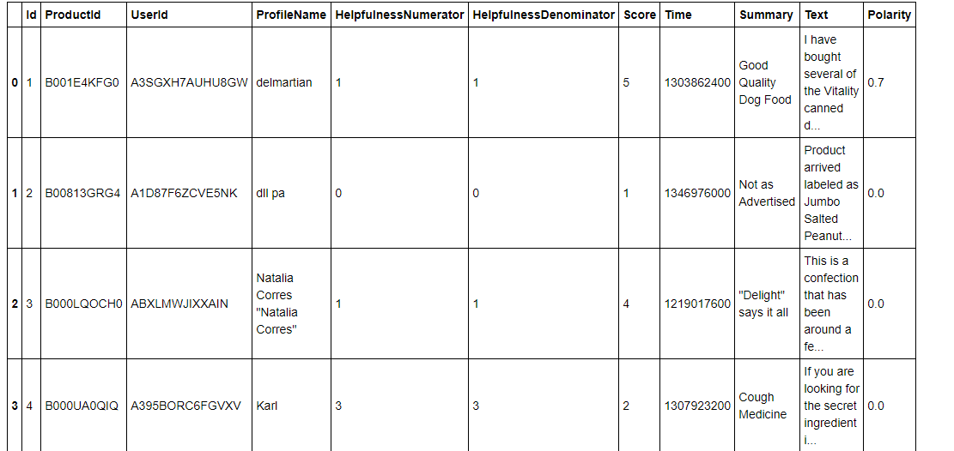

Slide 6
Exploratory Data Analysis (EDA)
After collecting data, wrangling data then exploratory analyses were carried out. The following insights were explored through exploratory analyses.
Predicting ratings based on reviews
Rating vs number of reviews
Top 10 most purchased products
Positive and negative words
Word cloud for different ratings, brand name, etc

Slide 7
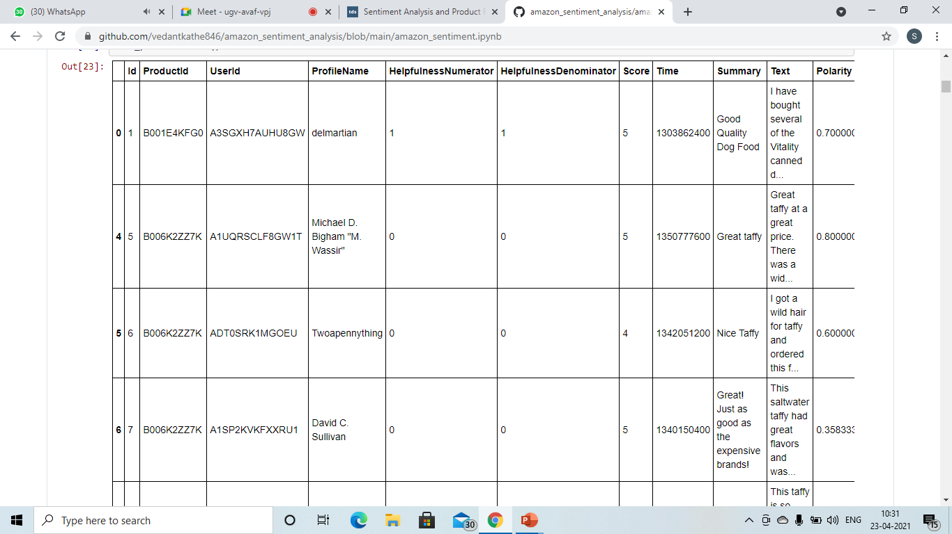
Predicting ratings based on reviews

Slide 8
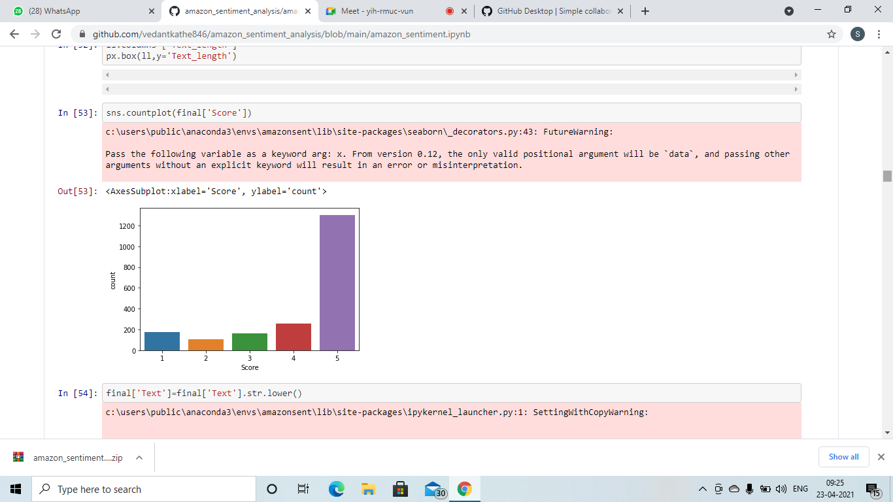
Rating vs number of reviews

Slide 9
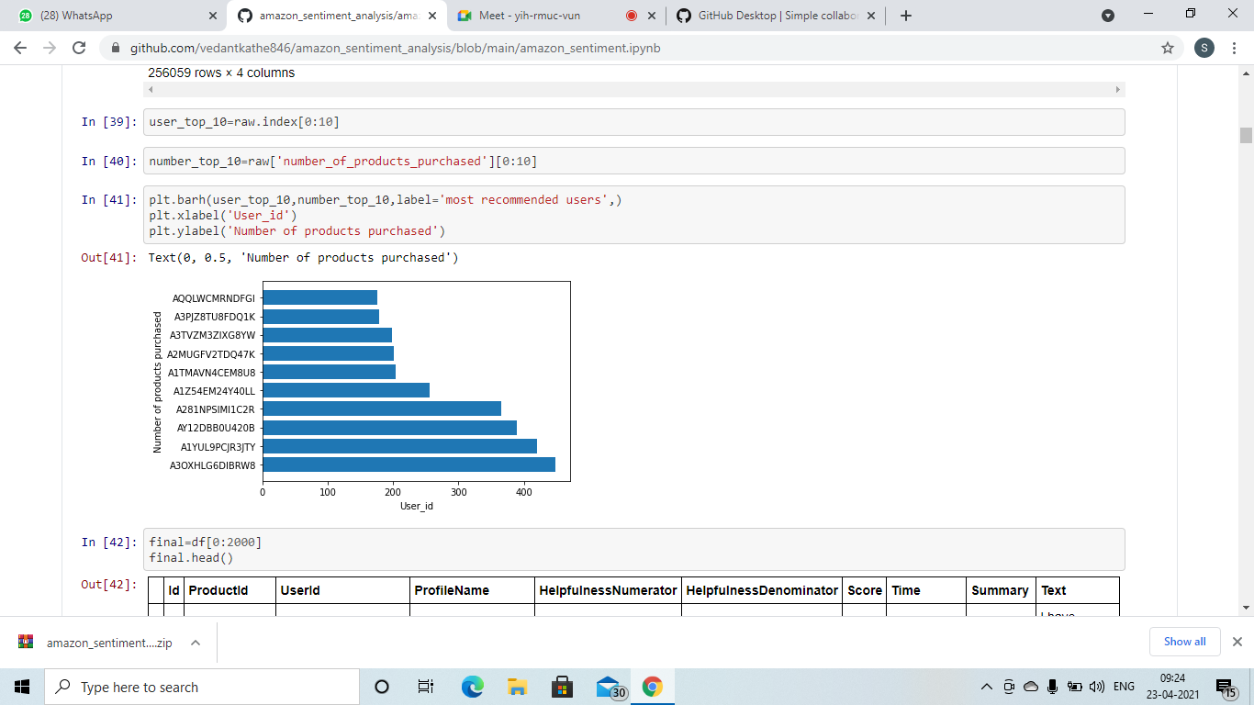
Top 10 purchased products

Slide 10
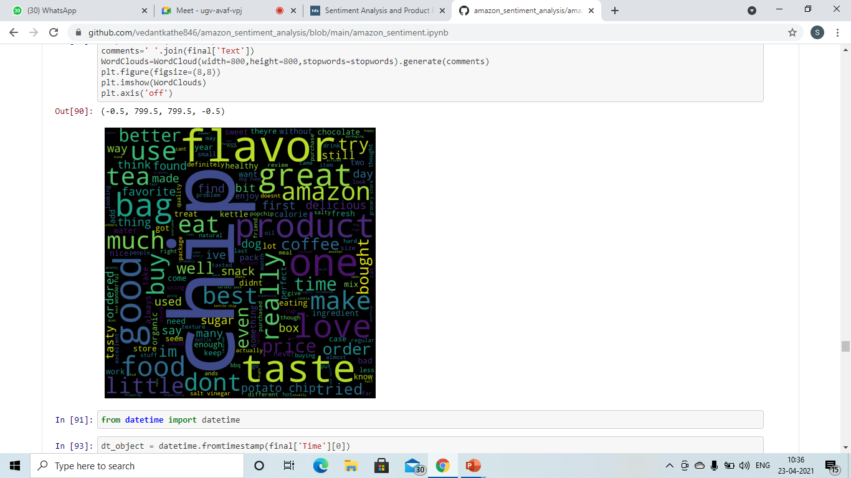
Positive and negative words

Slide 11
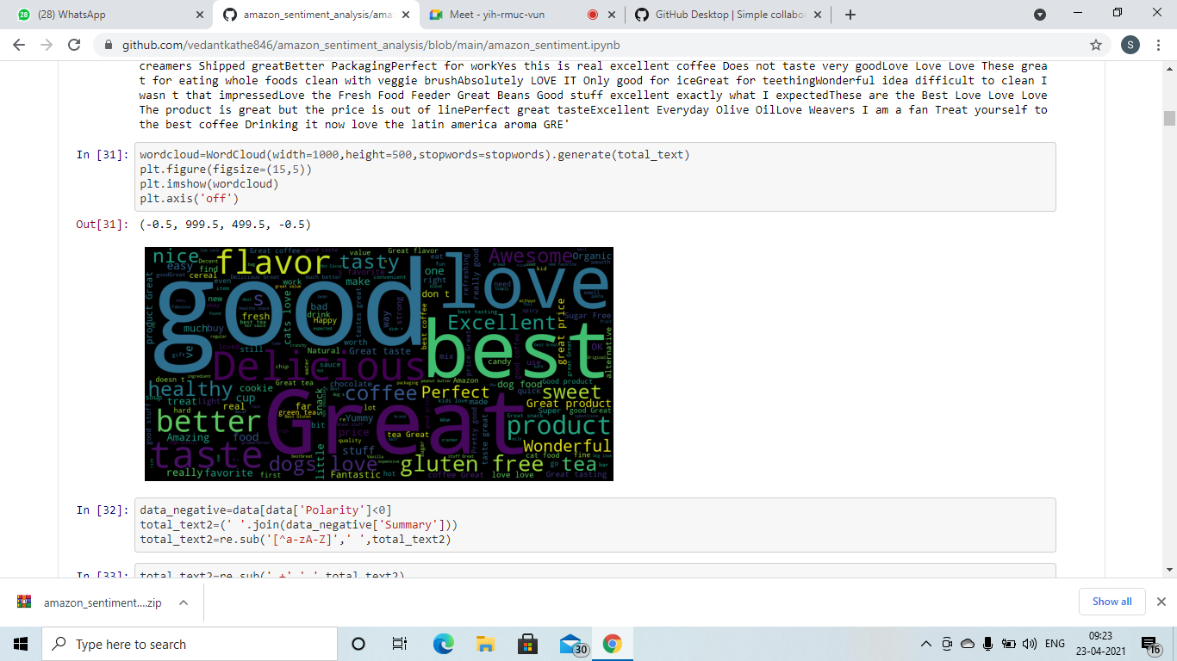
WORD CLOUD FOR DIFFERENT RATINGS, BRAND NAME.
The word cloud from good rating reviews for the above product. It shows major insight in terms of sellers perspective. It indicates most of the positive customers agree with “great”, “good” and least with “great product”.

Slide 12
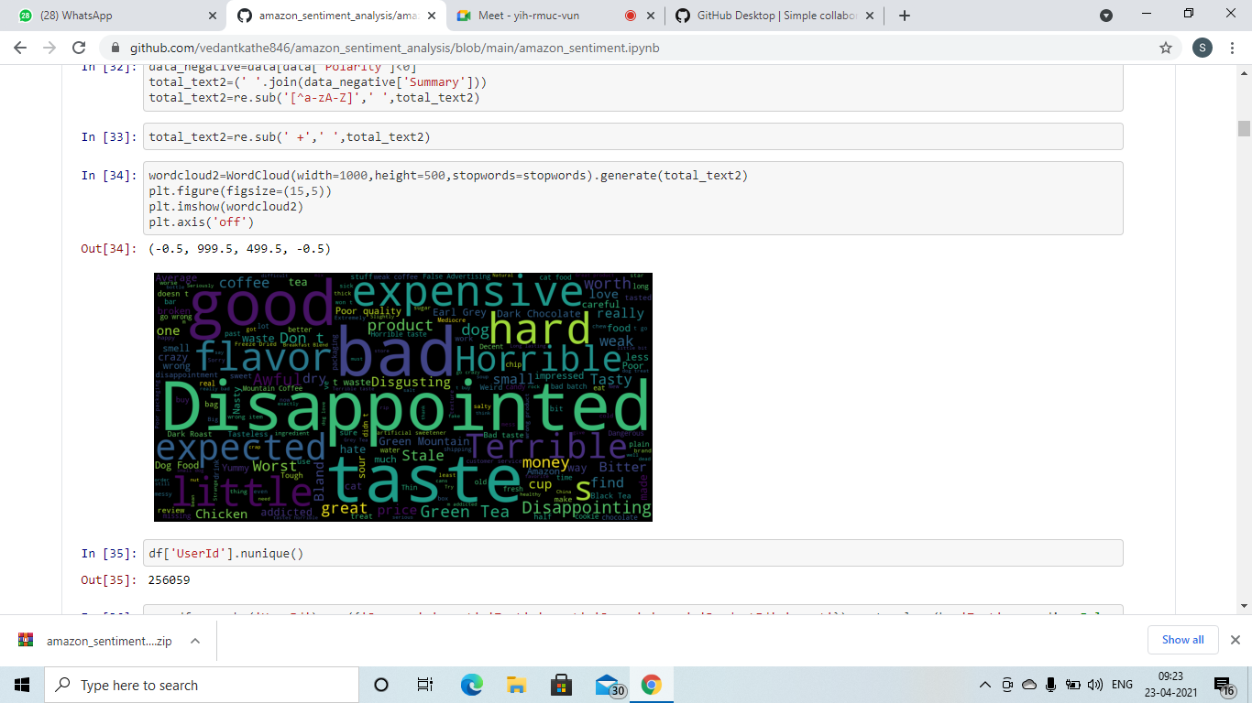
Similarly, the word cloud from bad rating reviews for the above product. It indicates most of the customers agree with “Disappointed” and “expensive”. From the sellers perspective, this product needs to be updated with “reasonable pricing” and “quality” in order to get positive feedback from customers.

Slide 13
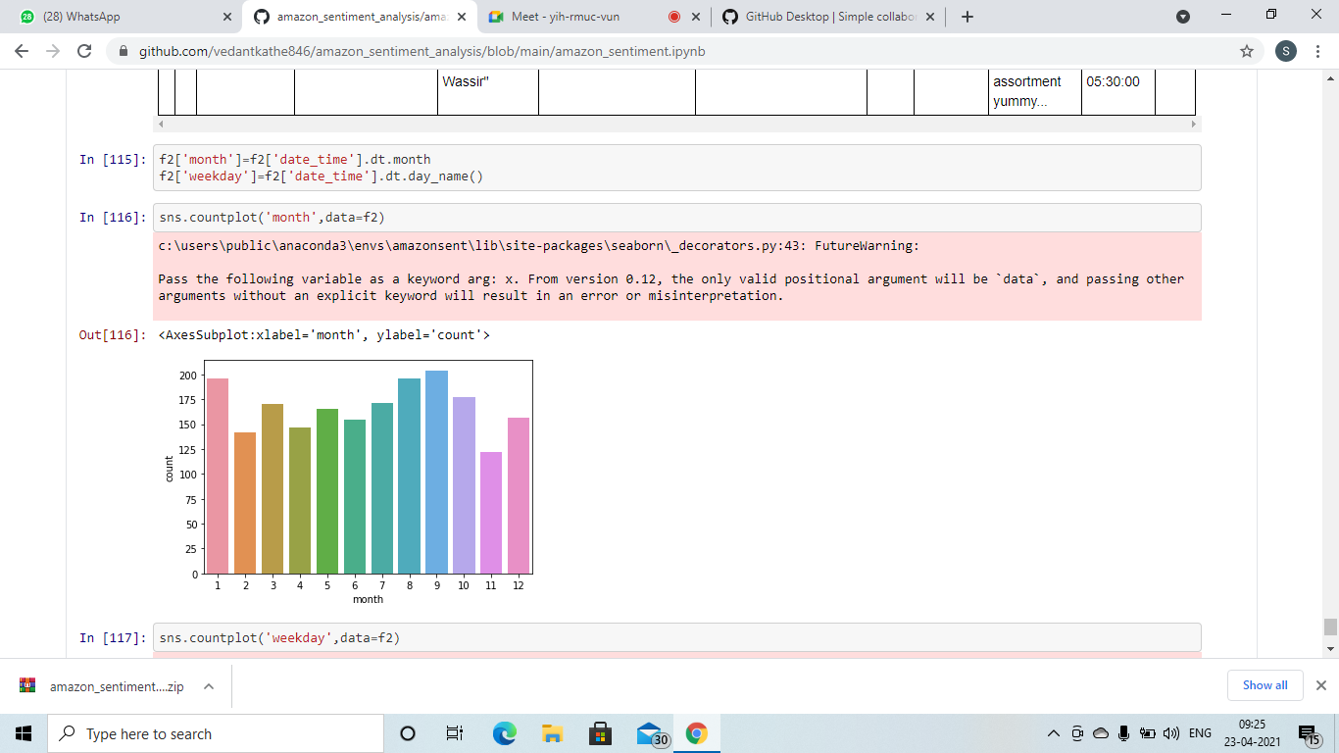

reviews on monthly basis

Slide 14
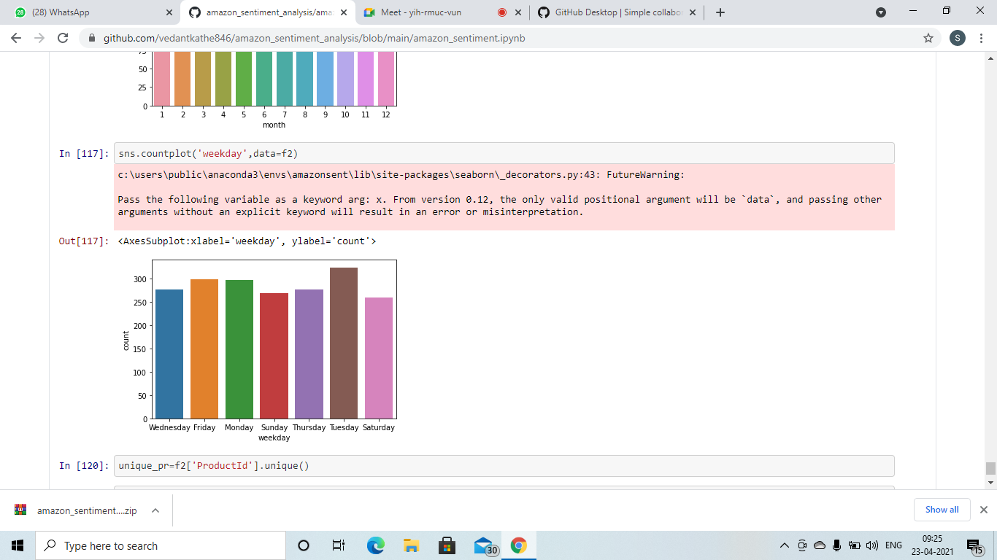
Reviews on weekly basis

Slide 15
Thank you

